Slide 1
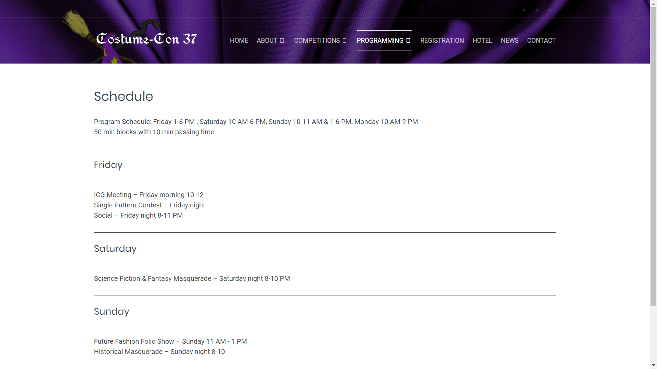
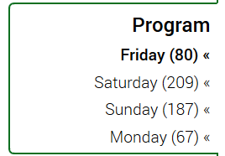
List of panels sorted by date and time
Drop Down (Rooms)
Search Bar (Panelists)
Sort
By
Day

